Slide 1


Sentiment Analysis On Text Surveys
Alvanou Marianna (p2822201)
Vlachakis Sotirios (p2822228)

Slide 2
AGENDA
Introduction – Our Goal
Dataset Overview – Data Processing
Methodology
Tools
Comments
Members

Slide 3
PRIMARY GOALS
Understand the customer
What service the company has?
What are the problems?
Prevent Negative Comments

Slide 4
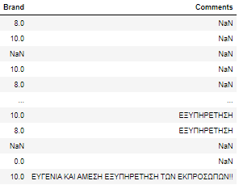
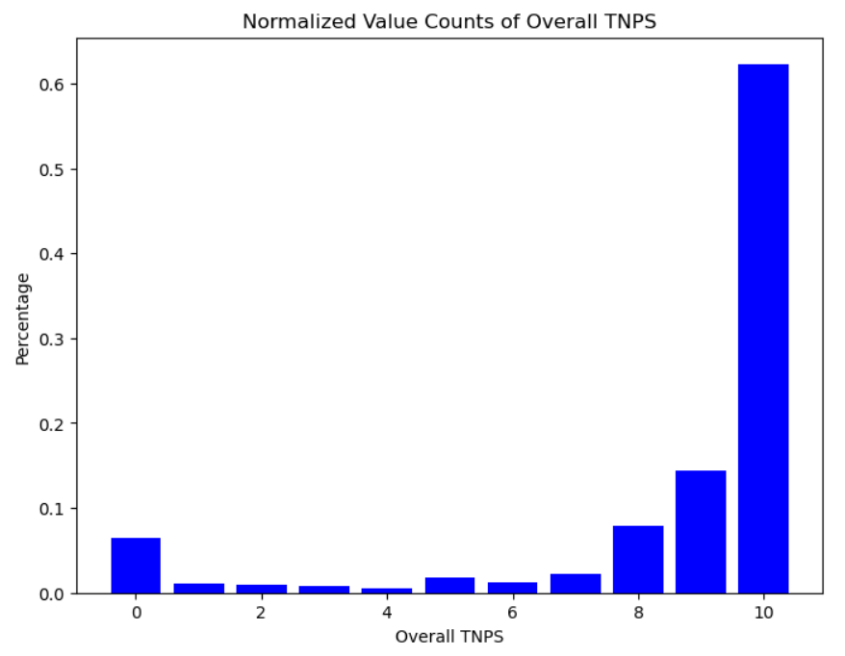
Dataset Overview – Data Processing
Split the data:
Train
Validation
Test
Data of May23
26064 comments
Remove regular expression pattern
Convert all letters to lowercase
Remove stopwords
After data cleaning: 14927 surveys
BRAND SCORE | SENTIMENT
9-10 | Positive
7-8 | Neutral
0-6 | Negative
Largest part of our dataset was positive surveys (76.7%)
Neutral are the 10,2% of comments
Negative feelings emerged from 13.1% of surveys

Slide 5
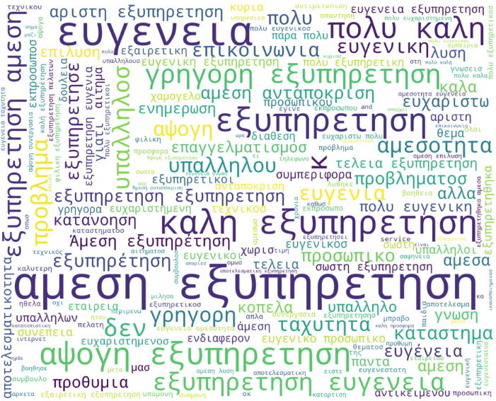
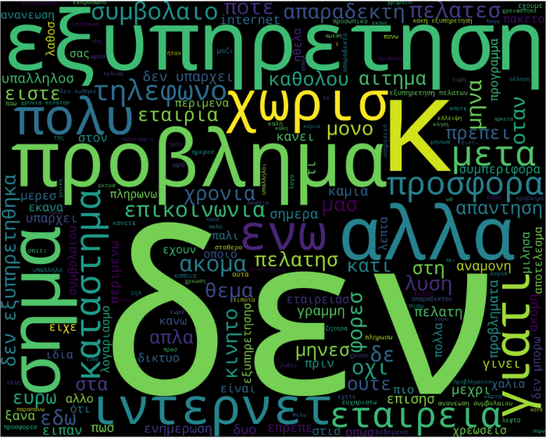
Word Cloud
Positive Words
Negative Words

Slide 6
Methodology 1. Feedforward Neural Network 2. Sequential Model 3. ABSA

Slide 7
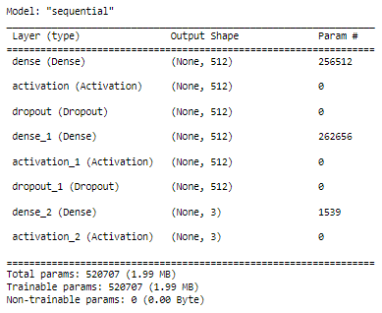
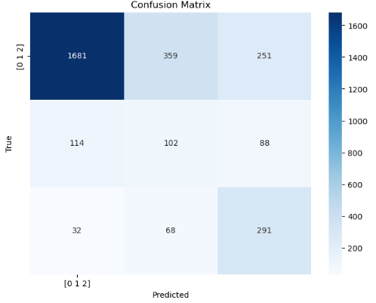
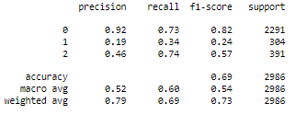
FEEDFORWARD NEURAL NETWORK
Label (Sentiment): Column Vectorizer – One Hot Encoder
Comments: Column Vectorizer – Count Vectorizer
Model Compile:
Loss – Categorical Crossentropy
Adam Optimizer
Class Weight
0: 0.43
1: 3.27
2: 2.54
Epochs : 10
EVALUATION METRICS
AUC : 0.793
Accuracy: 69.46 %
Categorical Crossentropy: 74.75 %

Slide 8
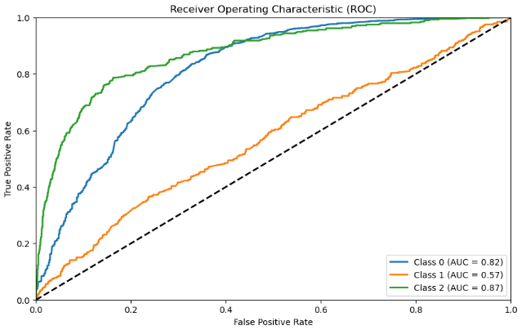
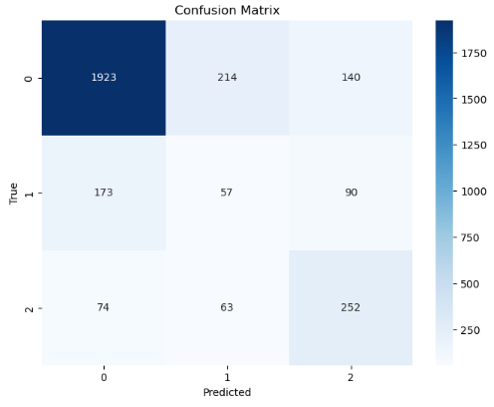
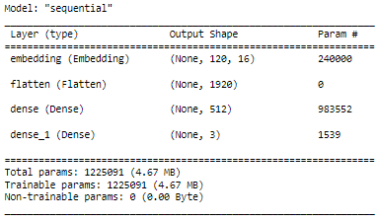
SEQUENTIAL MODEL
Label (Sentiment): Column Vectorizer – One Hot Encoder
Comments: Column Vectorizer – Count Vectorizer
Model Compile:
Loss – Categorical Crossentropy
Adam Optimizer
Class Weight
0: 0.43
1: 3.27
2: 2.54
Epochs : 10
EVALUATION METRICS
AUC : 0.753
Accuracy: 74.75 %
Categorical Crossentropy: 78.16 %

Slide 9
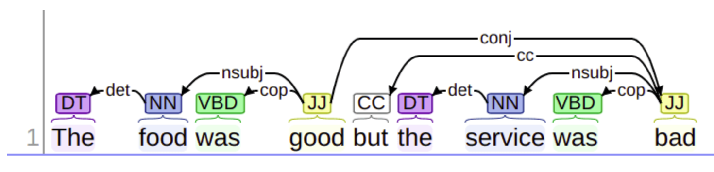
Aspect based Sentiment Analysis
We tried a different approach than before. Translated our surveys and pursued ABSA (Aspect Based Sentiment Analysis).
Lowercased & Tokenized our surveys
POS (Part of Speech) Tagging & Dependency Parsing (grammatical relationships between words e.g., subject, object, modifier) for each sentence
In our case we made Nouns our aspects.
Sample Sentence:
“The Sound Quality is great, but the battery life is very bad."

Slide 10
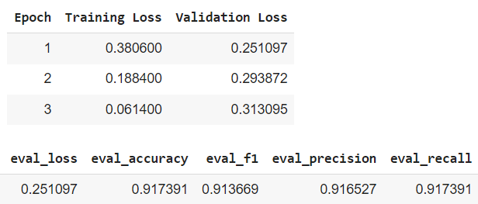

Aspect based Sentiment Analysis
Some basic Metrics
We stopped at the 1st epoch because of the decrease of training loss and rise of validation loss, which in the latter epochs could indicate overfit.
Although, because our data are imbalanced as we saw earlier, we will also calculate the balanced accuracy of our model.

Slide 11
Tools
Oracle SQL to extract the dataset
Jupiter Notebooks
Google Colab

Slide 12
Comments
Our future work will be to test with more data from different time points in order to see the models' predictions and how well or not they perform. Then we'll collect surveys from a different company and apply the models.

Slide 13
MEET OUR TEAM
ALVANOU MARIANNA
VLACHAKIS SOTIRIS
Statistics & Insurance Science
Coworkers
Extract the data
Data cleaning
Create Models
Write the report
Presentation
Communication with the professor
Data cleaning
Create Models
Write the report
Presentation

Slide 14
TIMELINE
26/06 - 09/07
Business Case, Data Collection – Processing & Dataset Overview
10/07 – 08/09
Create the Models
14/08 – 27/08 & 11/09 – 17/09
Write the Report and Presentation
Oct 23
Presentation

Slide 15
THANK YOU

